Slide 1



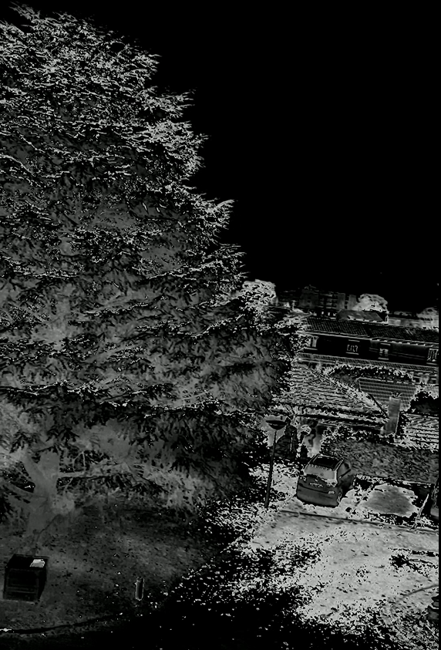
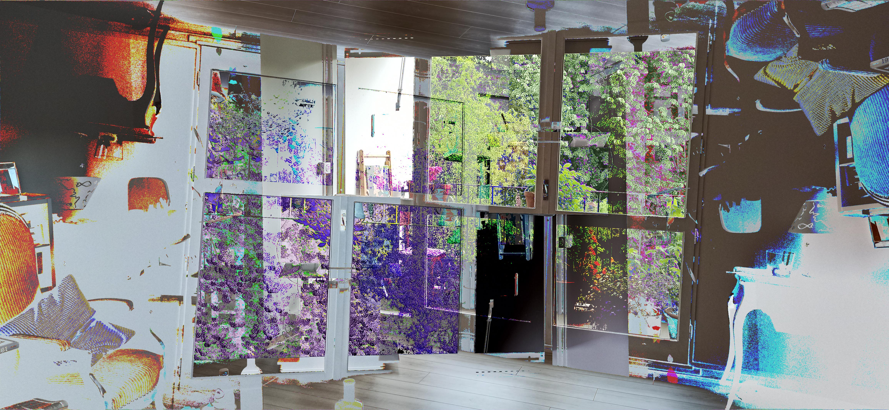
Video Modifier
Code a program capable of applying graphical changes on a video, like color modifying
Also works with GIFs or single images
Fast
Python
Pillow
OpenCV
WIP project, currently only works for videos, and is very slow. I might re-code the project in another language
Adaptation to new Python libraries
Optimization

Slide 2




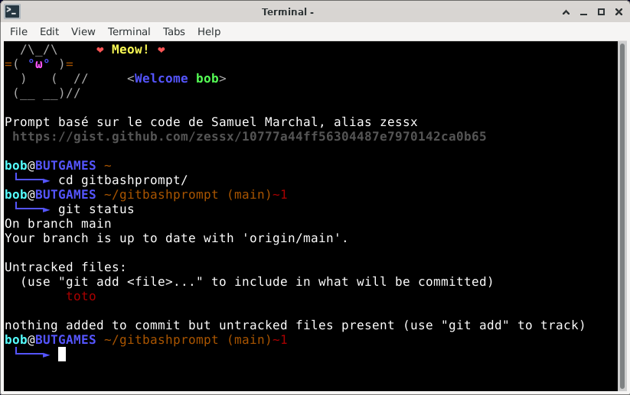
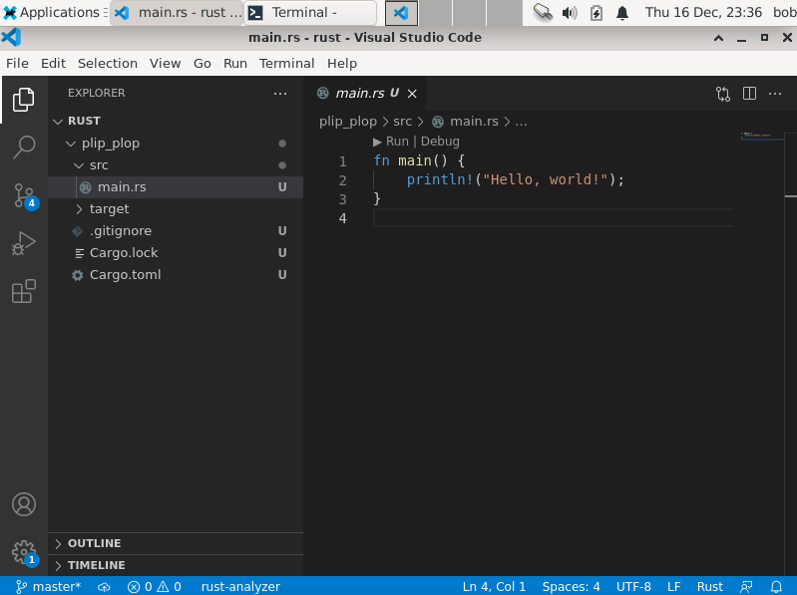
Virtual Machine Set Up
Create an environment to code in Rust on Linux with VMware
Have Rust, Git and Visual Studio Code installed
Informative bash prompt to work with Git
VMware Workstation Player
A Debian 11 Rust programming environment to work in teams
Different permissions for different users
Respect of the specifications
Usage of multiple Operating Systems
Experience with teamwork

Slide 3


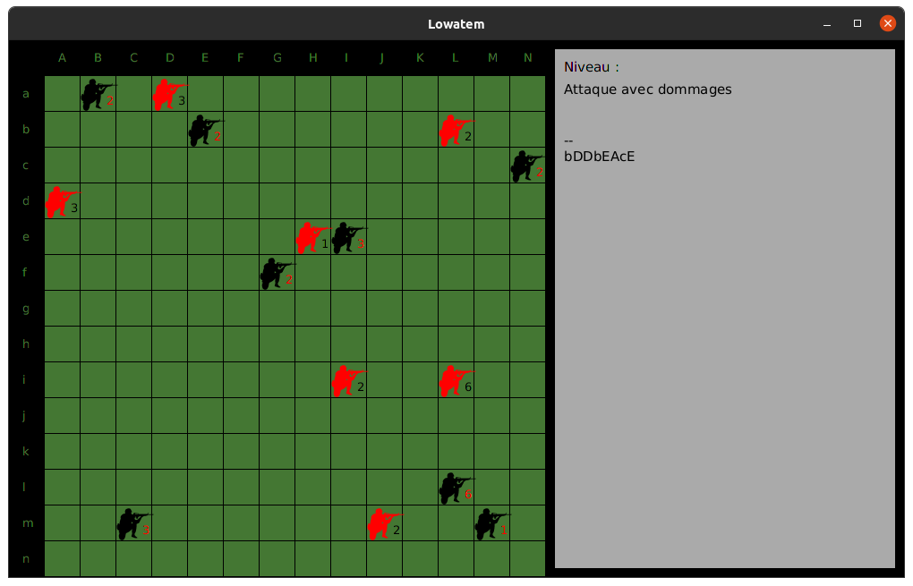
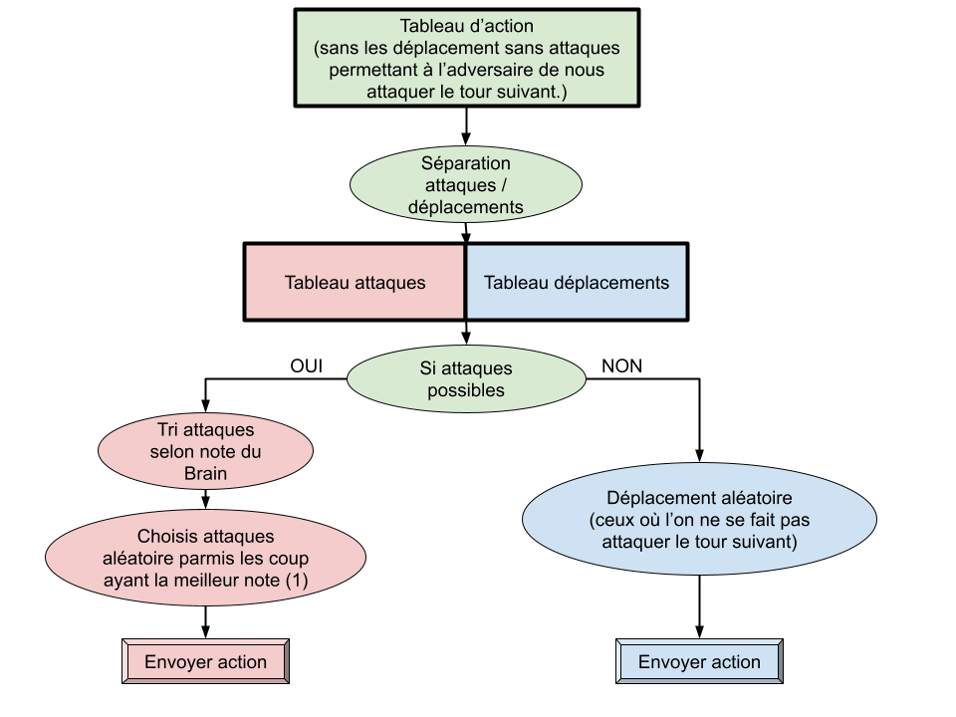
Coding a board game: Lowatem
Code the different rules for how the game works
Code two different AIs to play the game with two different strategies
Java
LibreOffice Calc
A chess-like type of game, here about soldiers
One AI playing the “best” move it can, based on calculations made on a spreadsheet
One AI based on the Minimax algorithm
More problem solving capabilities
Brainstorming with other people to find understand better complex concepts

Slide 4


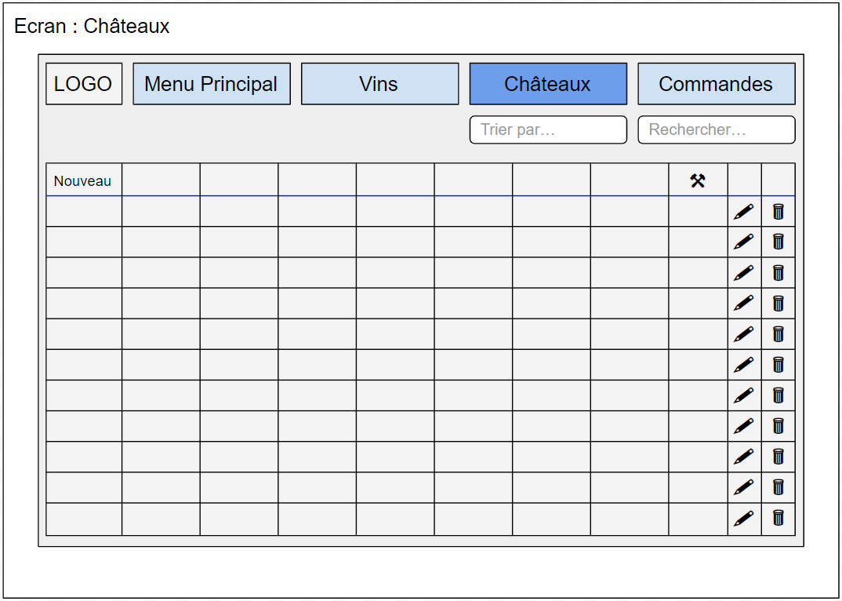
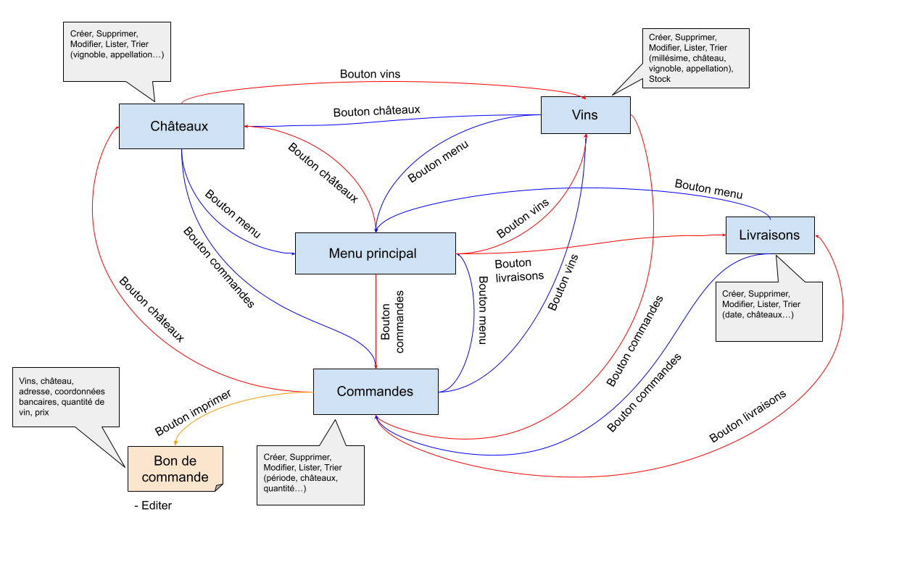
Database Creation
Create a database to store information relating to wine buying and reselling
Create a mock-up of a software that would use this database
Microsoft SQL Server
SQL Server Management Studio
A functional database for a Bordeaux selling company
A mock-up of the software that could be used to interact with the database
Creation of a database in a real-life setting
Experience with creating mock-ups
Experience with teamwork

Slide 5


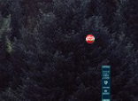
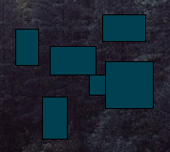
Pong
Make a Pong type of game, playable in two player mode.
Game variations with four balls, obstacles.
Processing (Java) programming
Creation of graphics
Pong in a kind of forest
Initiation to programming with Processing/Java
Progress with quality of code

Slide 6



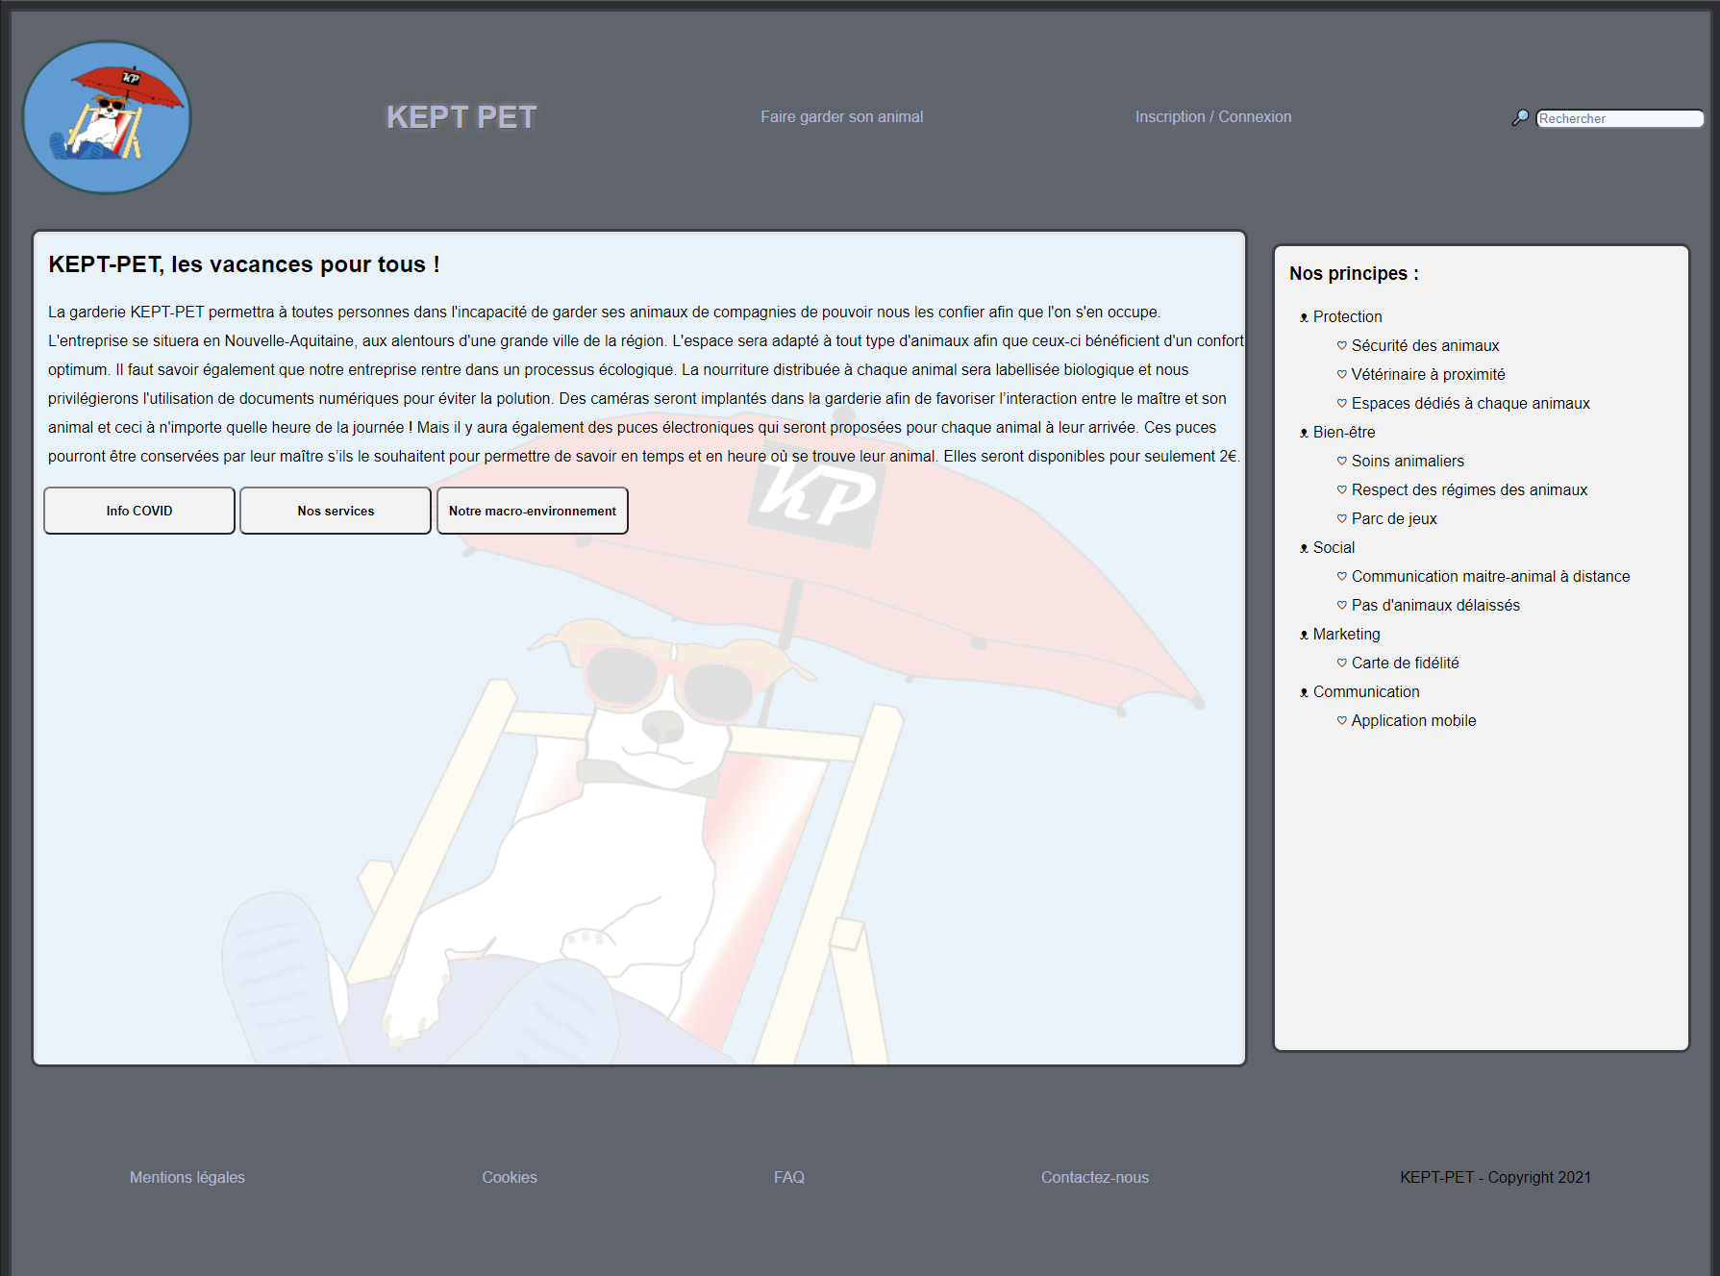
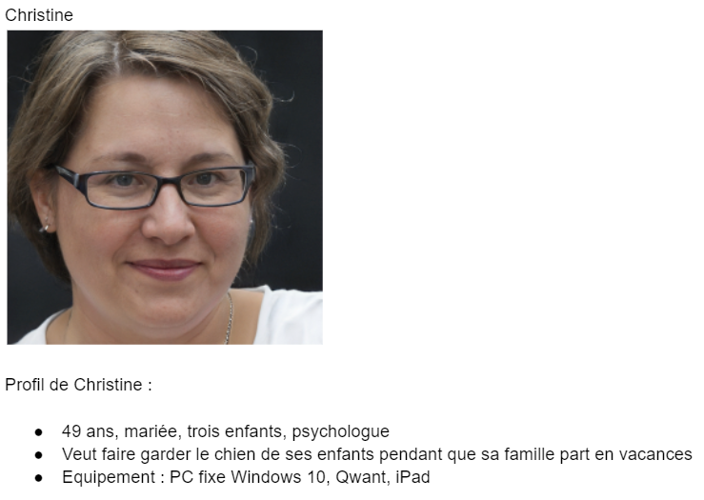

Creation of website for a fictive company
Create a website for a company, with everything a “professional” website should have
Have a “Persona”, a potential client the website should correspond to
HTML, CSS
Visual Studio Code
A website for a pet daycare, corresponding to a certain view of what clients might want
Better understanding of how HTML and CSS work
Experience with teamwork

Slide 7

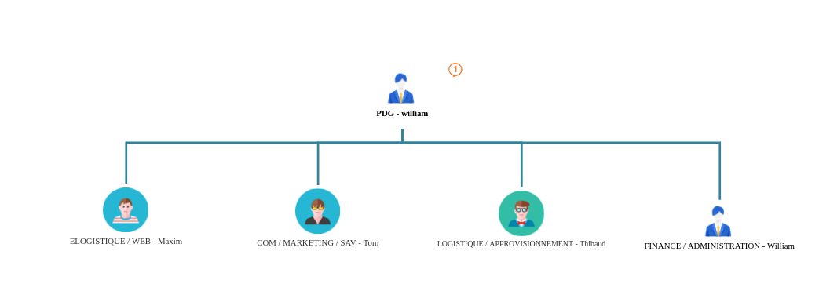
Creation of a fictive company
Create some kind of start-up related to IT
Define its structure, strategy, etc
Legal knowledge
A company for ordering online material for workspace and gaming related activities
Its strategy, and a detailed SWOT analysis of it
Deeper understanding of what a company is, and what it does
Experience with teamwork

